Slide 1
WELCOME TO PRESENTATTION
BY GANESH PANDY

Slide 2
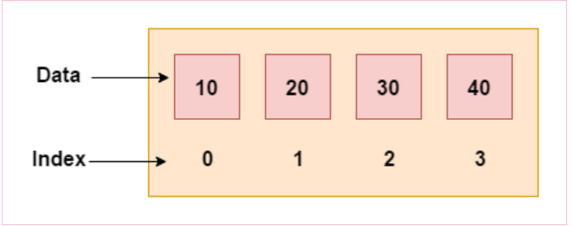
Arrays
Arrays are used to store multiple values in a single variable, instead of declaring separate variables for each value.
To declare an array, define the variable type with square brackets:
string[] cars;
We have now declared a variable that holds an array of strings.
To insert values to it, we can use an array literal - place the values in a comma-separated list, inside curly braces:
string[] cars = {"Volvo", "BMW", "Ford", "Mazda"};

Slide 3
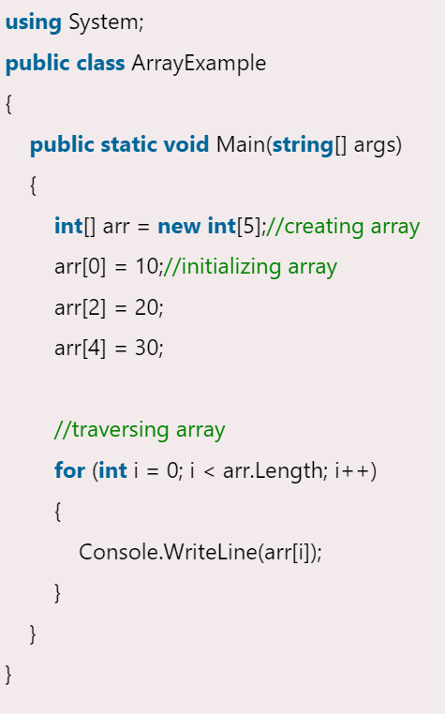
Let's see a simple example of C# array, where we are going to declare, initialize and traverse array.

Slide 4
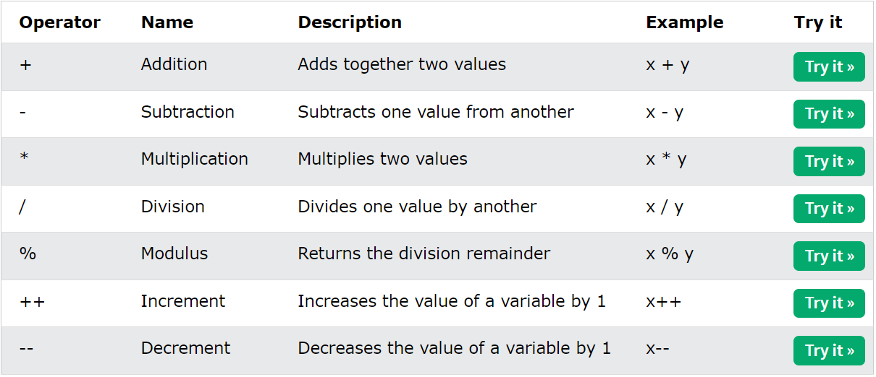
Operators
An operator is simply a symbol that is used to perform operations. There can be many types of operations like arithmetic, logical, bitwise etc.
Arithmetic Operators
Arithmetic operators are used to perform common mathematical operations:

Slide 5
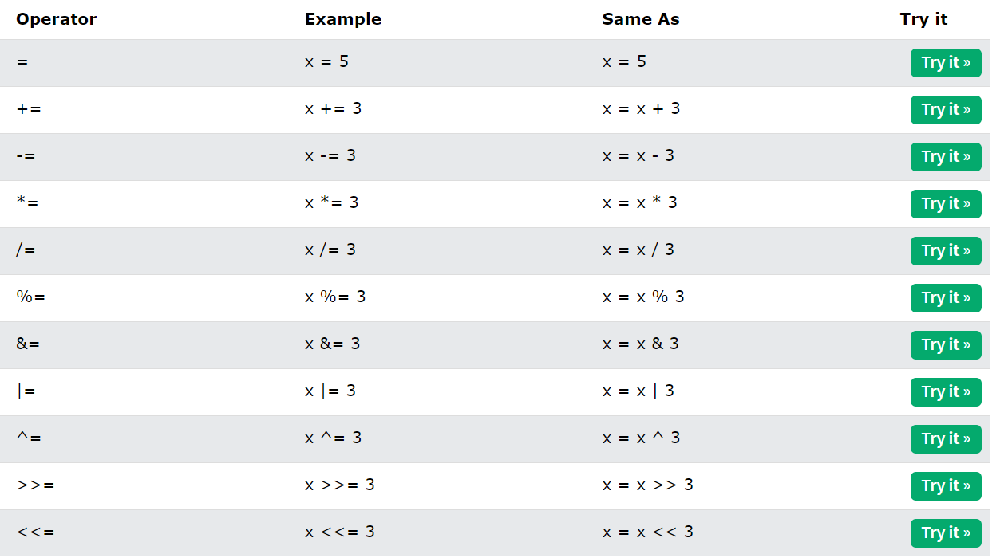
Assignment Operators
Assignment operators are used to assign values to variables.
A list of all assignment operators:

Slide 6
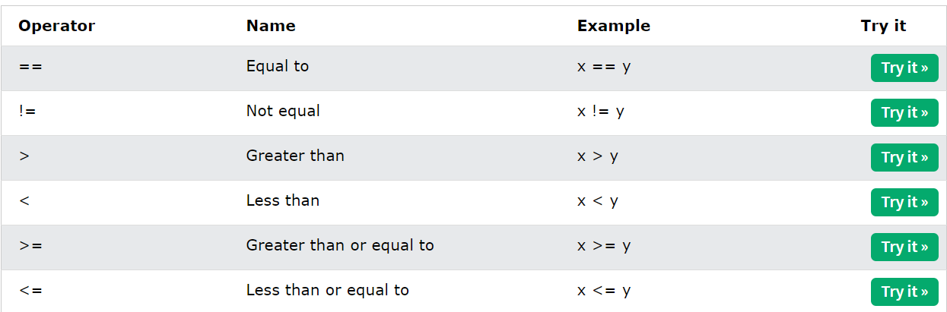
Comparison Operators
Comparison operators are used to compare two values (or variables). This is important in programming, because it helps us to find answers and make decisions.
The return value of a comparison is either True or False.
A list of all comparison operators:

Slide 7
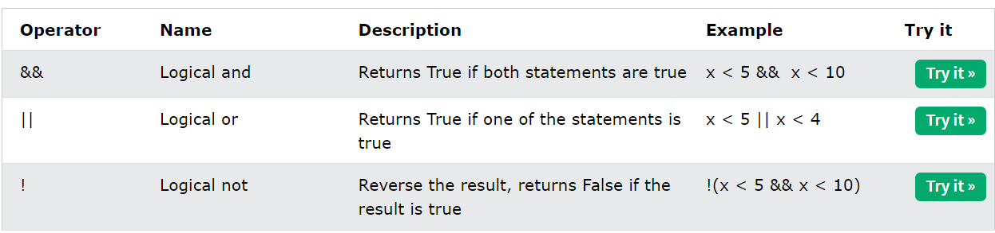
Logical Operators
As with comparison operators, you can also test for True or False values with logical operators.
Logical operators are used to determine the logic between variables or values:

Slide 8
Control statement:
In C# programming, the if statement is used to test the condition. There are various types of if statements in C#.
if statement
if-else statement
nested if statement
1.The if Statement
Use the if statement to specify a block of C# code to be executed if a condition is True.
Example:
if (20 > 18)
{
Console.WriteLine("20 is greater than 18");
}

Slide 9
The else Statement
Use the else statement to specify a block of code to be executed if the condition is False.
Example:
int time = 20;
if (time < 18)
{
Console.WriteLine("Good day.");
}
else {
Console.WriteLine("Good evening.");
}

Slide 10
else if Statement
Use the else if statement to specify a new condition if the first condition is False.
Example
int time = 22;
if (time < 10)
{
Console.WriteLine("Good morning.");
}
else if (time < 20)
{
Console.WriteLine("Good day.");
}
else
{
Console.WriteLine("Good evening.");
}

Slide 11
Loops
Loops can execute a block of code as long as a specified condition is reached.
Loops are handy because they save time, reduce errors, and they make code more readable.
While Loop:
The while loop loops through a block of code as long as a specified condition is True:
Example
int i = 0;
while (i < 5) {//0,
Console.WriteLine(i);
i++; //0
}

Slide 12
Do/While Loop
This loop will execute the code block once, before checking if the condition is true, then it will repeat the loop as long as the condition is true.
Example
int i = 0; do
{ Console.WriteLine(i);//0
i++;
}
while (i < 5);

Slide 13
For Loop
When you know exactly how many times you want to loop through a block of code, use the for loop instead of a while loop:
Example
for (int i = 0; i < 5; i++)
{
Console.WriteLine(i);//0
}
foreach Loop
There is also a foreach loop, which is used exclusively to loop through elements in an array:
Example
string[] cars = {"Volvo", "BMW", "Ford", "Mazda"};
foreach (string i in cars)
{
Console.WriteLine(i);
}

Slide 14
Switch Statements
Use the switch statement to select one of many code blocks to be executed.
The switch expression is evaluated once
The value of the expression is compared with the values of each case
If there is a match, the associated block of code is executed
The break and default keywords will be described later in this chapter
break Keyword:
When C# reaches a break keyword, it breaks out of the switch block.
This will stop the execution of more code and case testing inside the block.
When a match is found, and the job is done, it's time for a break. There is no need for more testing.
default Keyword: The default keyword is optional and specifies some code to run if there is no case match:
Continue Keyword:
The continue statement breaks one iteration (in the loop), if a specified condition occurs, and continues with the next iteration in the loop.

Slide 15
int day = 4;
switch (day) {
case 1:
Console.WriteLine("Monday");
break;
case 2:
Console.WriteLine("Tuesday");
break;
case 3:
Console.WriteLine("Wednesday");
break;
case 4:
Console.WriteLine("Thursday");
break;
case 5:
Console.WriteLine("Friday");
break;
case 6:
Console.WriteLine("Saturday");
break;
case 7:
Console.WriteLine("Sunday");
break; }

Slide 16
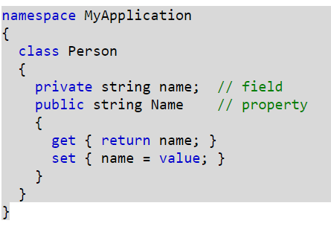
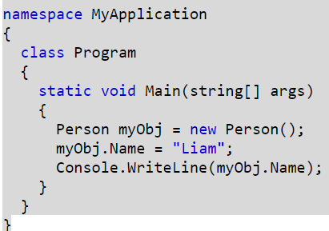
Properties
private variables can only be accessed within the same class (an outside class has no access to it). However, sometimes we need to access them - and it can be done with properties.
A property is like a combination of a variable and a method, and it has two methods: a get and a set method:
Example

Slide 17
THANK YOU

